Slide 1

Week 6-
Exploring models of reflection

Slide 2
Module lecturer-Tayo Alebiosu
Health and Social Care
Continuous Professional Development
Contact me: tayo.alebiosu@lsclondon.co.uk

Slide 3

Aim;
Analyse personal practice developments that are responsive to changing needs of the sector.
Learning outcomes At the end of this lesson students will be able to ;
Exploring critical incidents analysis and its role in healthcare practice
Describe typical models used for reflection in health and social care practice

Slide 5

Presenting your assignment
Title page-Your student number, the module and submission date
Content page
Introduction
Font –Ariel, Times New Roman
Font size -12
Line spacing – 1.5
Paragraphing-Not too short or too long
Page number
In text referencing using Harvard referencing style
Reference list using Harvard referencing style
Reference list should be in alphabetical order
Proof read for grammar errors
Submit as a single document i.e. a word document or Pdf
Conclusion

Slide 6

Last session recap (10 minutes)
Students ….
Explored the definition of reflection, its role and the impact of conducting reflective practice in health and social care sector
Explained the role of reflection within Continuing Professional Development.
Described typical models used for reflection in health and social care practice

Slide 7
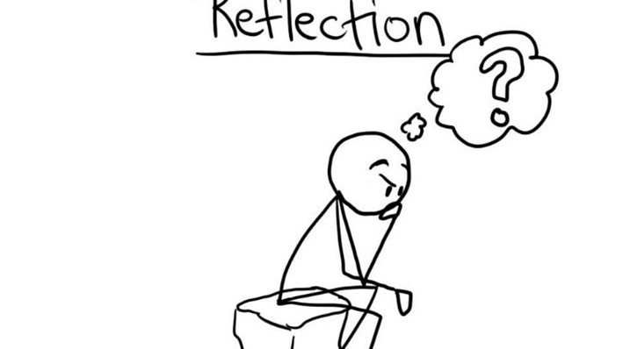
What is reflection?
Reflection is the process of making sense of an experience in order to learn and improve as a practitioner.1 Often, we reflect as part of our everyday practice without being aware that we are doing it – for example, on the way home from work.
Using reflection within health and social care has benefits for patients and the profession. In order to do this effectively, reflection involves describing, analysing and evaluating experiences from practice in a way that helps you make sense of it. Reflection can occur prior to, during and often after an event or experience, all of which can allow learning.

Slide 8

Models (or Frameworks) of Reflection
Models, sometimes known as frameworks for reflection, encourage a structured process to guide the act of reflection.
There is no right model. It is important to choose the one that feels most comfortable for you and best assists you to learn from your experience.

Slide 9
There are many opportunities that may prompt reflection, for instance:
Team meetings.
Reading a journal or article about a topic and then applying the learning to your practice.
Discussion with other clinical staff about critical incidents or near misses including lessons learned and good practice.
Compliments and complaints from patients, which may involve changing practice or policies and procedures.
GP case conferences where complex patients are discussed.
CPD sessions that relate to your role.
Using these opportunities you can choose to reflect informally or formally as part of the revalidation process.

Slide 10
Recording reflections
Whether you prefer to reflect formally or informally, it is best to record reflections on a regular basis as it can be easy to forget details over time. It is more beneficial to your practice to reflect regularly because the more you reflect the easier the process becomes.
If you are reflecting informally, the reflection may not be overly detailed at this point, you may just use bullet points to record the most important points at the time, then go back to writing more details when you can.
Alternatively, you can record your reflections using an audio feature on your phone or a Dictaphone, which you can transcribe or listen to later on.

Slide 11
When reflecting there are a few key things to consider:
Make time to reflect.
Value the benefits it may bring to your practice.
Use a structure only if you feel comfortable doing so.
Write notes – even if these are short, bullet points and in informal language, that is fine
Using tools such as a reflective diary can allow you to see how you have developed both personally and professionally.
Reflection has been shown to provide valuable professional development. It also enables you to learn more deeply about a variety of situations and events, not just for revalidation.

Slide 12

Now… lets discuss about three models of reflection

Slide 13

Reflective model according to Kolb
Kolb’s reflective model is referred to as “experiential learning”.
The basis for this model is our own experience, which is then reviewed, analysed and evaluated systematically in three stages.
Once this process has been undergone completely, the new experiences will form the starting point for another cycle.

Slide 14
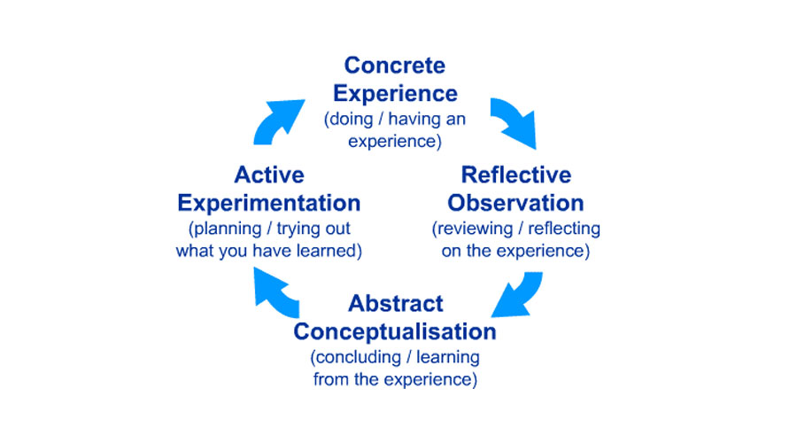

Slide 15

Concrete experience:
You consciously and physically experience a situation, which makes you realise that you need to reflect systematically in order to learn something new or improve on your existing skill and practice. At this stage you will make a note of the specific situation and just describe what you see, how you feel and what you think.
Reflective observation:
Having written down the description of the experience, it is now time to reflect more deeply on what has happened in that situation. The questions you need to ask yourself are: what worked? what failed? why did the situation arise? why did others and I behave the way we did?

Slide 16

Abstract conceptualisation:
The guiding question for this stage leads on from the questions in the reflective observation stage:
Also, this is the stage where you should consult colleagues and literature in order to get a better understanding and further ideas.
what could I have done better or differently? how can I improve? Initially, you try to find different ways for dealing with the situations and think up strategies for when you experience a similar situation again.

Slide 17

Active experimentation:
This stage is now practising the newly acquired theoretical knowledge. You take your own reflections and thoughts about improvements as well as the theories back into your practice and try out the new strategies.
Some of them will work, others won’t, so this is then automatically the basis for the new cycle. As the experiences within the active experimentation stage become the new “concrete experiences”.

Slide 18
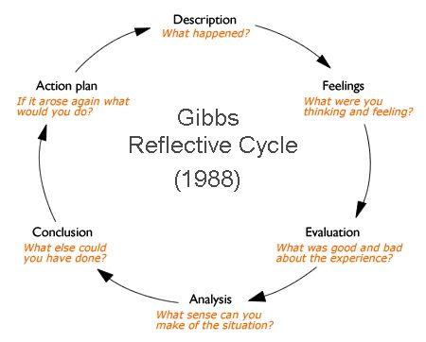

Slide 19
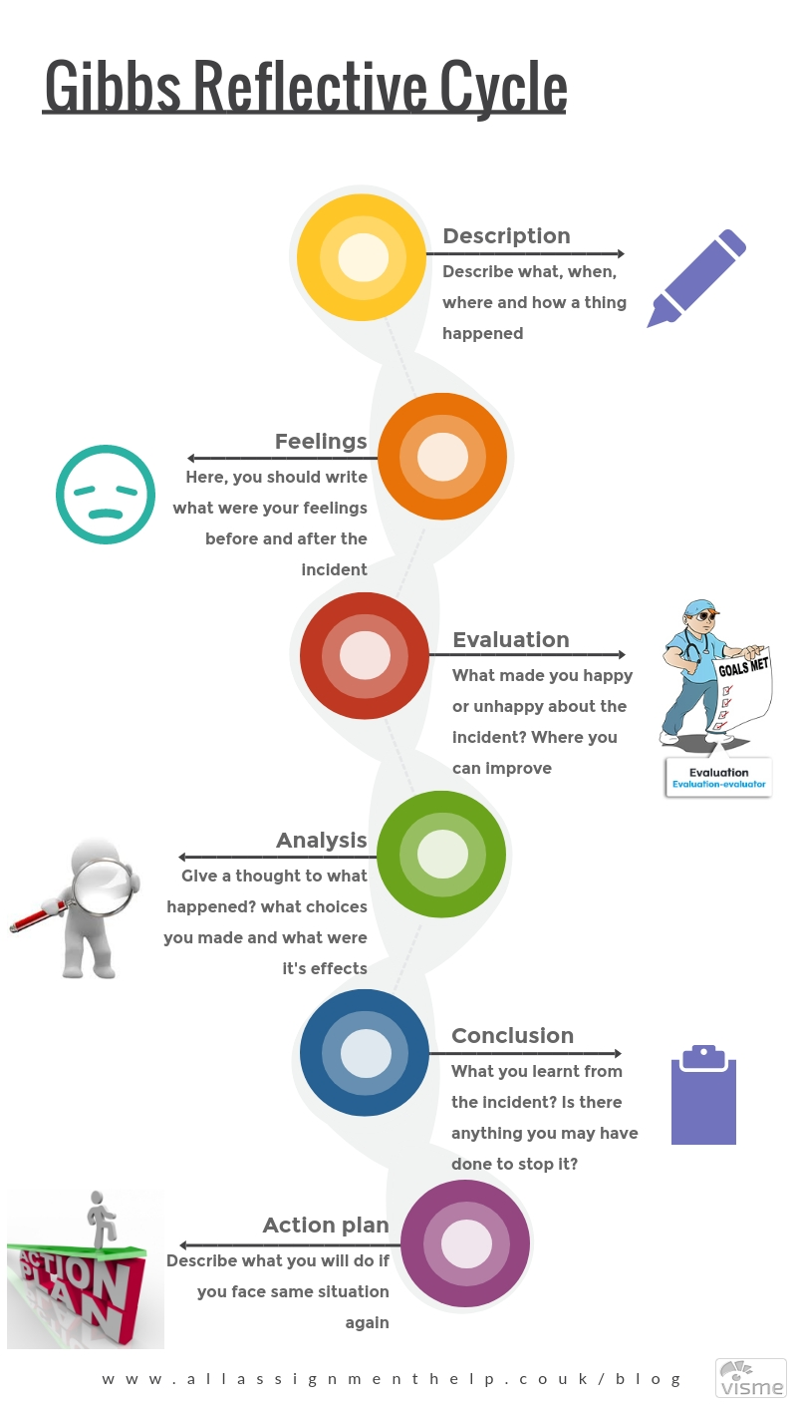

Slide 20

Reflective model according to Gibbs
The reflective model according to Gibbs is based on several stages, during which you are required to answer several questions in order to go as deep as possible with your reflections.
Gibbs suggests the following stages: description, feelings, evaluation, analysis, conclusions and action plan.
The idea of this model is to systematise reflections and isolate feelings. The different stages usually help to slow down our thought processes so that we don’t jump to conclusions too quickly.

Slide 21

Description:
What happened?
At this stage you are asked to describe the situation and not to make any judgements or draw conclusions. Try to be as detailed as possible, but remain descriptive.
Feelings:
What were your reactions and feelings?
Again you are not to analyse the situation, yet. You are asked to describe your emotional response to the situation you have experienced. Consider what you felt, how your body felt and what you did as well as how the others reacted to your actions.

Slide 22
Evaluation:
What was good or bad about the experience?
At this stage you are considering the situation and your responses more objectively to make your first value judgements.
You should also consider the experience from other people’s perspective in addition to your own.
This will help you understand if the situation was bad for you only, or if it was a bad experience for others, too.

Slide 23
Analysis:
What sense can you make of the situation? What was really going on? Were different people’s experiences similar or different?
Once you have considered the situation in an evaluative way, you can start to analyse it in greater detail by considering the above questions. At this stage you should also bring in ideas from outside the experience to help you. This could mean involving colleagues and peers in your reflections, but also to consult literature and theories in order to make sense of what happened.

Slide 24
What can be concluded from these experiences and the analyses you have undertaken? What can be concluded about your personal situation and your way of working?
When you draw conclusions you ought to consider the general applicability as well as your specific situation. Think about what your conclusions mean for you personally, for your immediate context and then more widely for others, too.
Conclusions:

Slide 25

Personal action plan:
What are you going to do differently in this type of situation next time? What steps are you going to take on the basis of what you have learnt?
In order for you to improve on your practice and learn from specific experiences you need to take this stage particularly seriously. Think about what you can do differently and how you will improve your practice.
Complete a simple action plan with key pointers about what you will do and how you will decide that your practice has improved.

Slide 26

Now … Schön reflective practice

Slide 27
So what is reflective practice according to Schön ?
Schön defines reflective practice as the practice by which professionals become aware of their implicit knowledge base and learn from their experience. He talks about reflection in action and reflection action.
Reflection in action is to reflect on behavior as it happens, whereas, Reflection on action reflecting after the event, to review, analyze, and evaluate the situation.
Another term he introduces is “knowing in action” to describe tacit knowledge.
Reflection according to Donald Schon is the ability of professionals to ‘think what they are doing while they are doing it’. He states that managing the indeterminate zones of professional practice requires the ability to think on the run and use previous experience to new conditions. This is important and needs the ability to reflect-in-action.

Slide 28
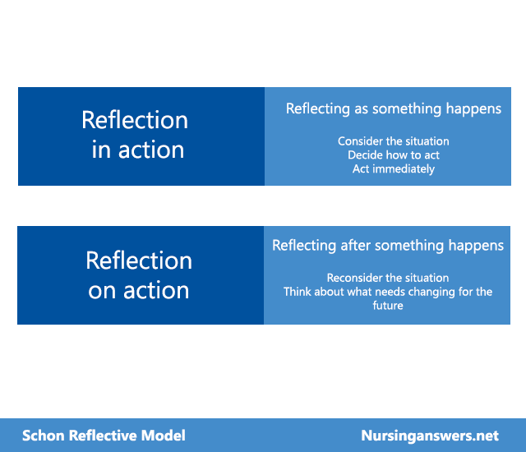

Slide 29
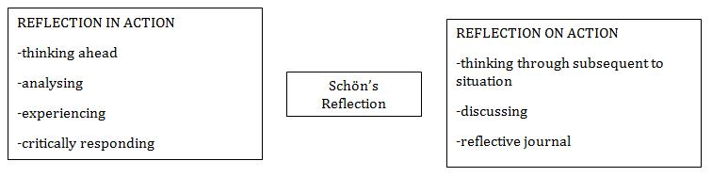

Slide 30
Schön (1991) presented the concept of 'reflection in action' and 'reflection on action':
Reflection in action Reflection on action
Experiencing
Thinking on your feet
Thinking about what to do next
Acting straight away
Thinking about something that has happened
Thinking what you would do differently next time
Taking your time
Schön's theory is that there are two types of reflection, one during and one after an activity or event.

Slide 31
Reflection in action
Experiencing
Thinking on your feet
Thinking about what to do next
Acting straight away
Reflection on action
Experiencing
Thinking on your feet
Thinking about what to do next
Acting straight away

Slide 32
What fields use Schön’s reflection in action model?
Various fields use Schon’s reflective model, though the most common are teaching and health and social care (This is partly because these professions promote continuing professional development (CPD), and reflective practice is a key component of CPD.
It is interesting to note that Schon defined professional practice (including the reflective process) as an ‘artistry’. Indeed, he believed that the practitioner’s ability to reflect upon and competently manage unique and difficult situations was a form of ‘artistry’.

Slide 33
Why is Schön’s model a good reflective model?
Schon’s model is a good reflective model, primarily because it emphasises the usefulness of reflecting whilst in action. However, speaking more generally, Schon’s theoretical perspective is positive and empowering because it recognises the special ‘intelligence’ or ‘artistry’ of the practitioner (Edwards, 2017).
Schon has lamented that, traditionally ‘the researcher’s role is distinct from, and usually considered superior to, the role of the practitioner’ (Schon, 1983, p.335). In contrast, however, Schon values the special role of the practitioner and instead helps them to access and nurture knowledge which they already have (via reflection), for the purposes of enhancing their practice (Kinsella, 2010).
Thus, it can be said that Schon’s model of reflection is particularly empowering for those who use it. It must, nevertheless, be recognised that there are weaknesses as well as strengths to this model, as will be described in more detail below.

Slide 34
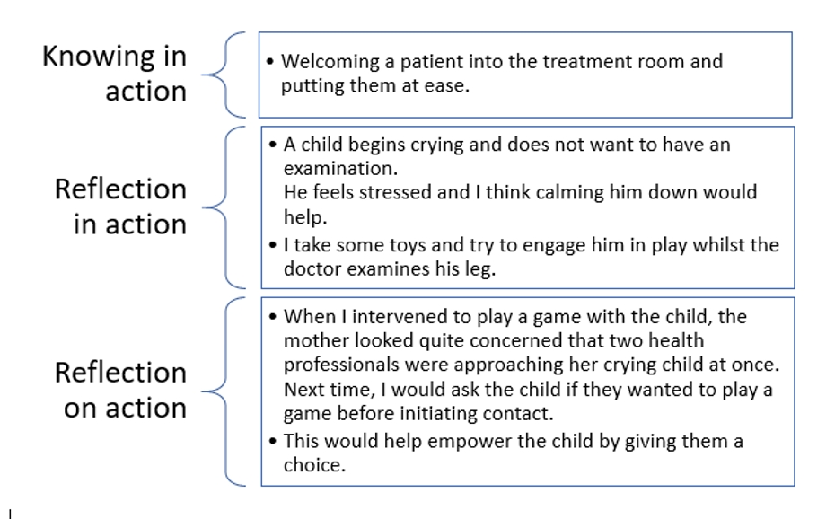
Schön’s reflective model: An example

Slide 35
Schön’s reflective model: An example
Above is an example of a nurse’s reflection using Schon’s reflective model (1983/1991). At the ‘knowing in action stage’, the practitioner began by considering the activities they know how to conduct effortlessly and without thought.
In the example, welcoming a patient is the skill that the nurse knows how to do intuitively.
At the ‘reflection in action’ stage, the nurse has reflected on an intervention she tried when attempting to calm down an unhappy child.

Slide 36
Schön’s reflective model: An example
Finally, the ‘reflection on action’ stage asked the practitioner to consider what went well/badly and what they would change next time.
The practitioner has stated how they would behave differently next time.
It is possible to see how, over time, this reflective process could reshape the practitioner’s ‘knowing in action’ statement.
That is, the practitioner may gradually begin to develop a new way of welcoming patients that will eventually become intuitive but will have incorporated insights from various instances of reflection (Kinsella, 2010).

Slide 37


Video Activity on reflection
In small group,
From the video clip below:
Students should identify:
How the doctor reflected on his practice
How he learnt from his mistakes
How reflection will help him to improve the quality of service to patients
And what needs to be done to improve patients services within the department.
Reflective Practice scene 1: https://youtu.be/c_MdkLzfTDU
Reflective Practice scene 2: https://youtu.be/F506D1PXXSg

Slide 38
Gibbs, G. (1988) Learning by Doing: A guide to teaching and learning methods. Further Education Unit, Oxford Brookes University, Oxford.
Kolb, D.A. (1984). Experiential learning: experience as the source of learning and development. Englewood Cliffs, NJ: Prentice Hall.
https://www.nicole-brown.co.uk/reflective-model-according-to-kolb/
https://www.nursinginpractice.com/professional/how-to-reflect-on-your-practice/
Reference:

